Slide 1
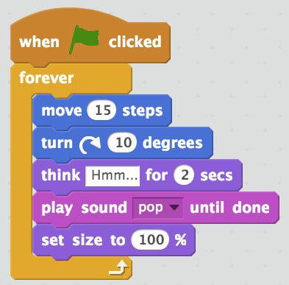

Coding and Computational Thinking in Primary School

Slide 2

STEM Education at KPS.
New Science Syllabus
An opportunity to change RFF came about – staff vote (science)
Designated Classroom for Science
Engineering and Robotics as a focus
Used Primary Connections as content units and swapped out 2 units per year for engineering challenges and robotics.
We used additional school funds to pay for ICT teacher for team teaching
We used Aboriginal funding for GATS programs in consultation with our ATSI community.

Slide 3
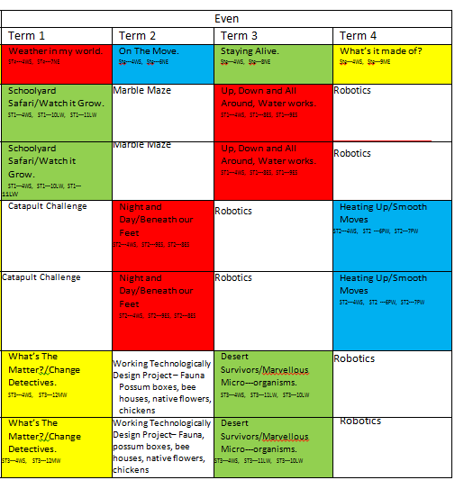
Scope and Sequence from Primary Connections with KPS adjustments

Slide 4
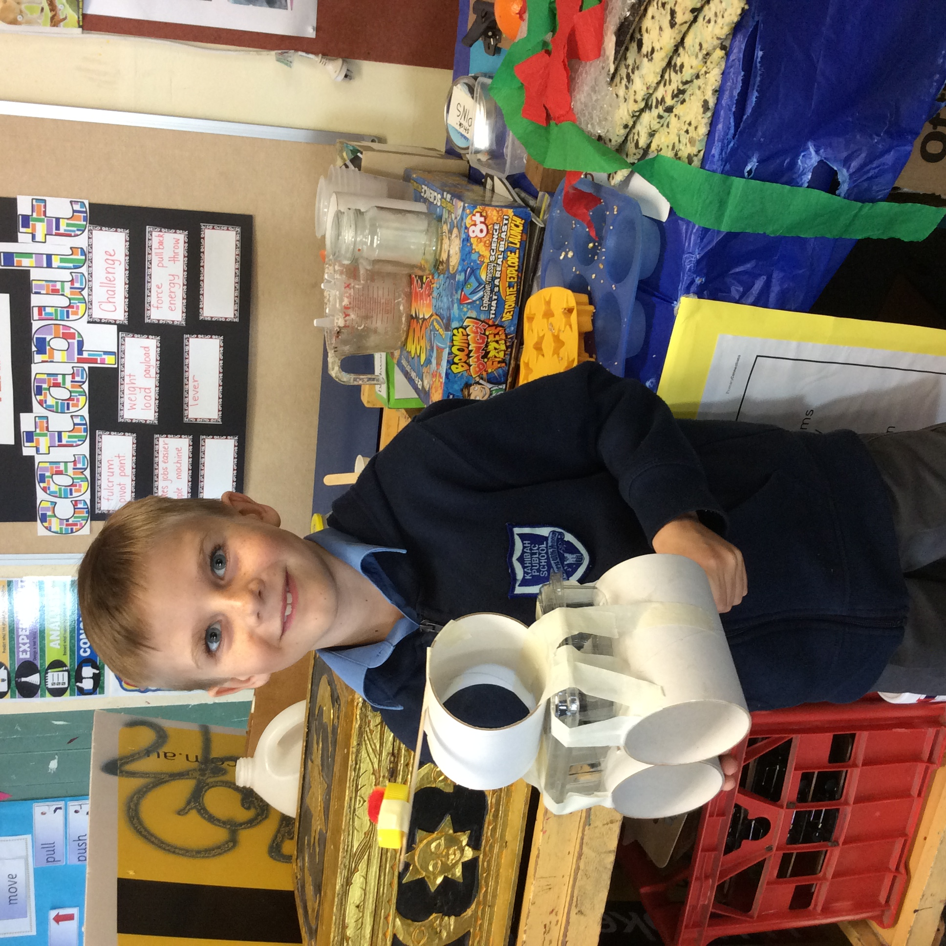
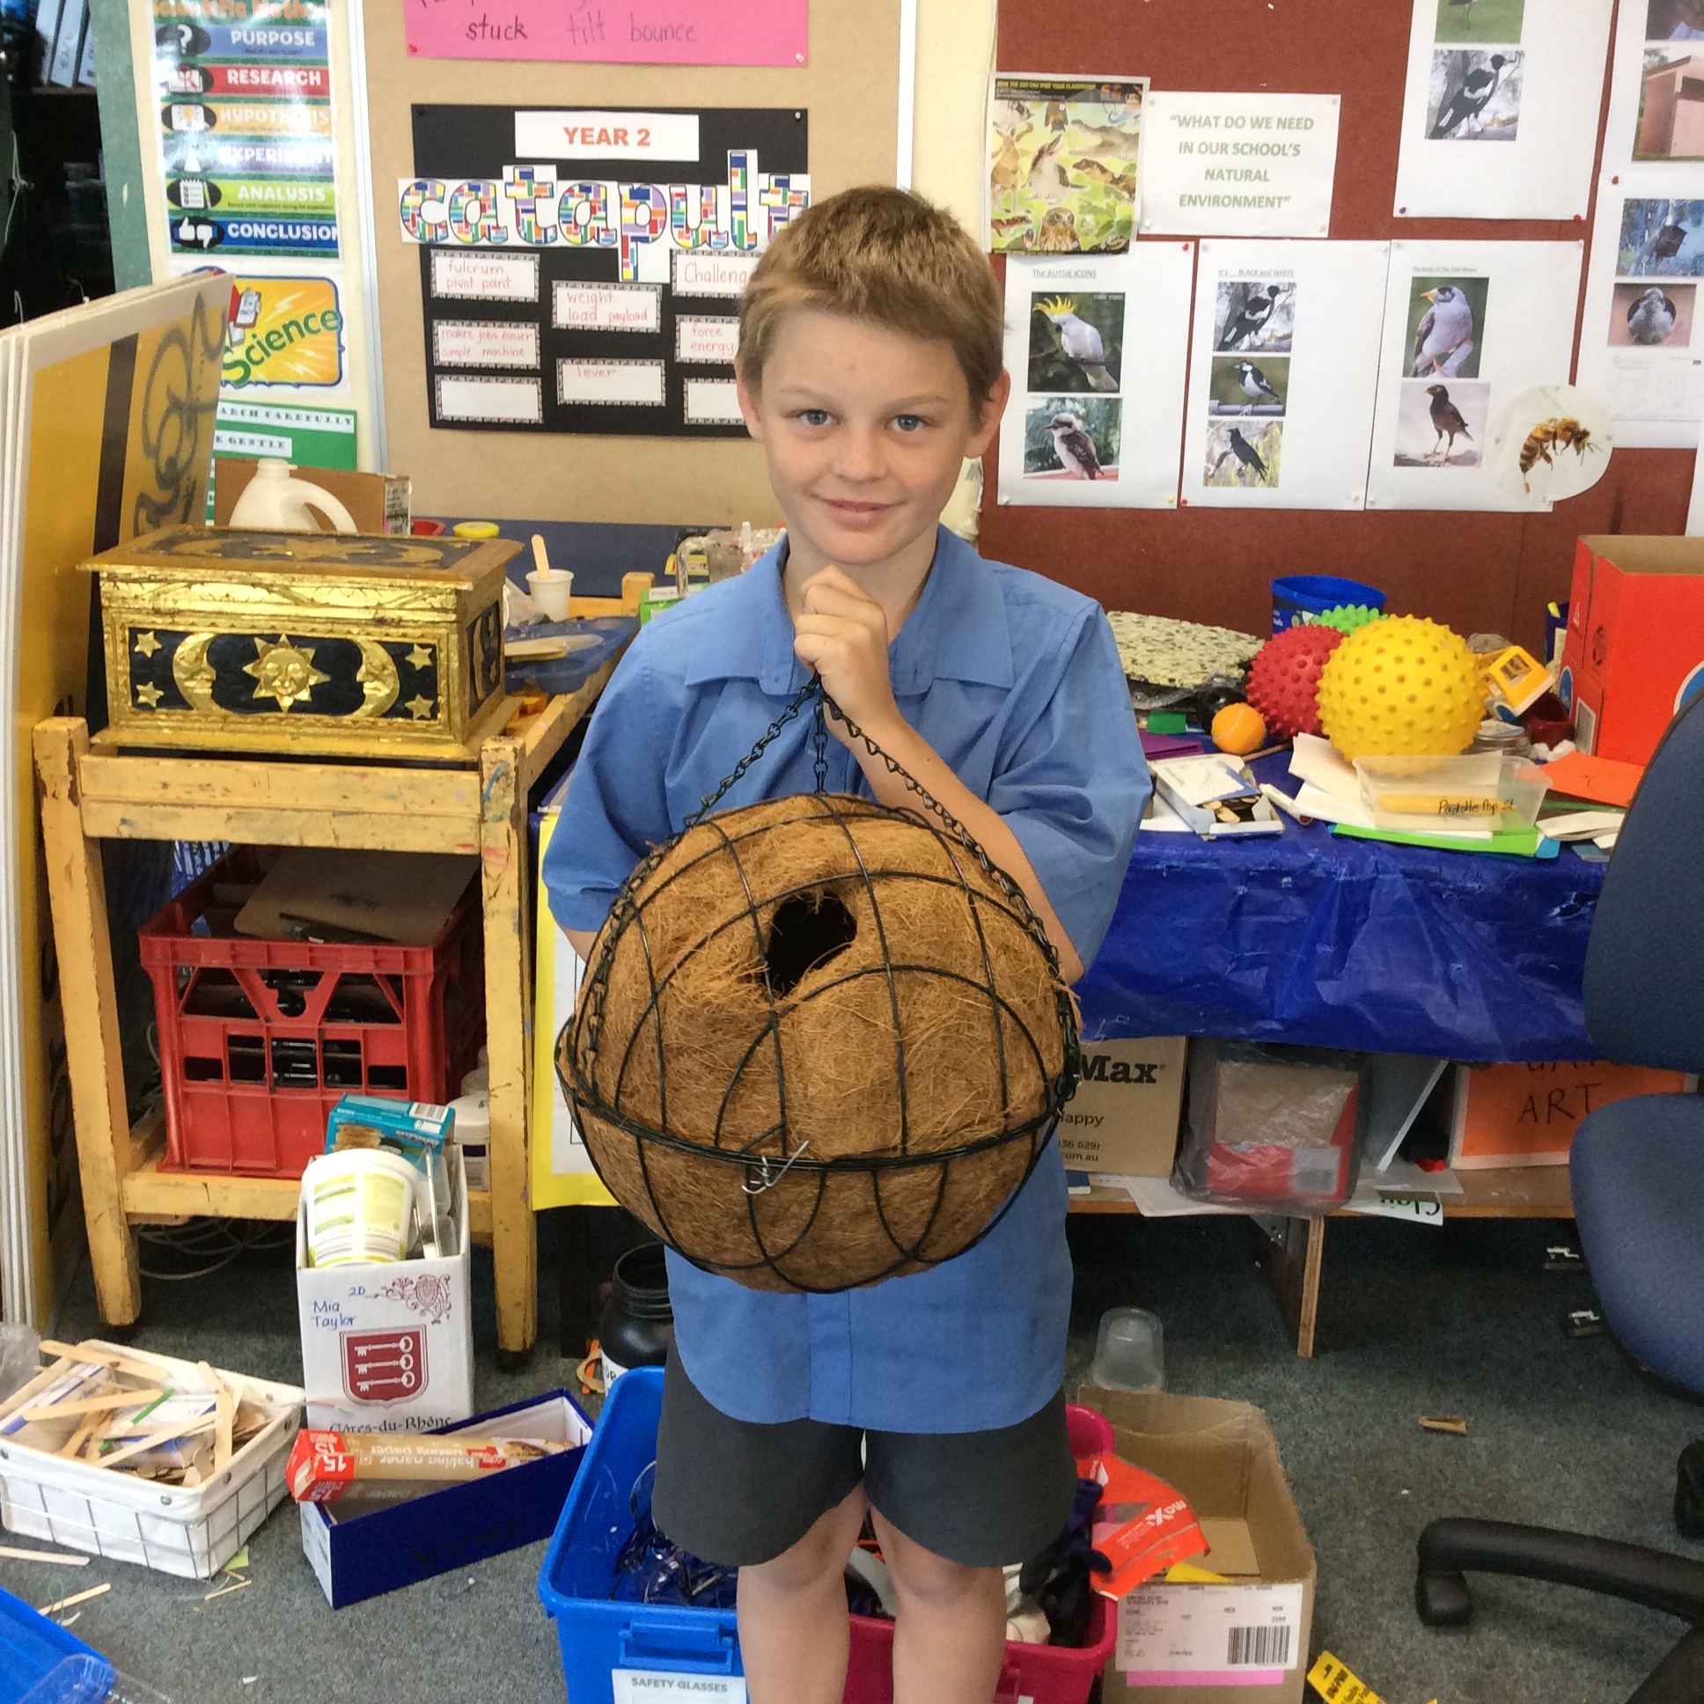
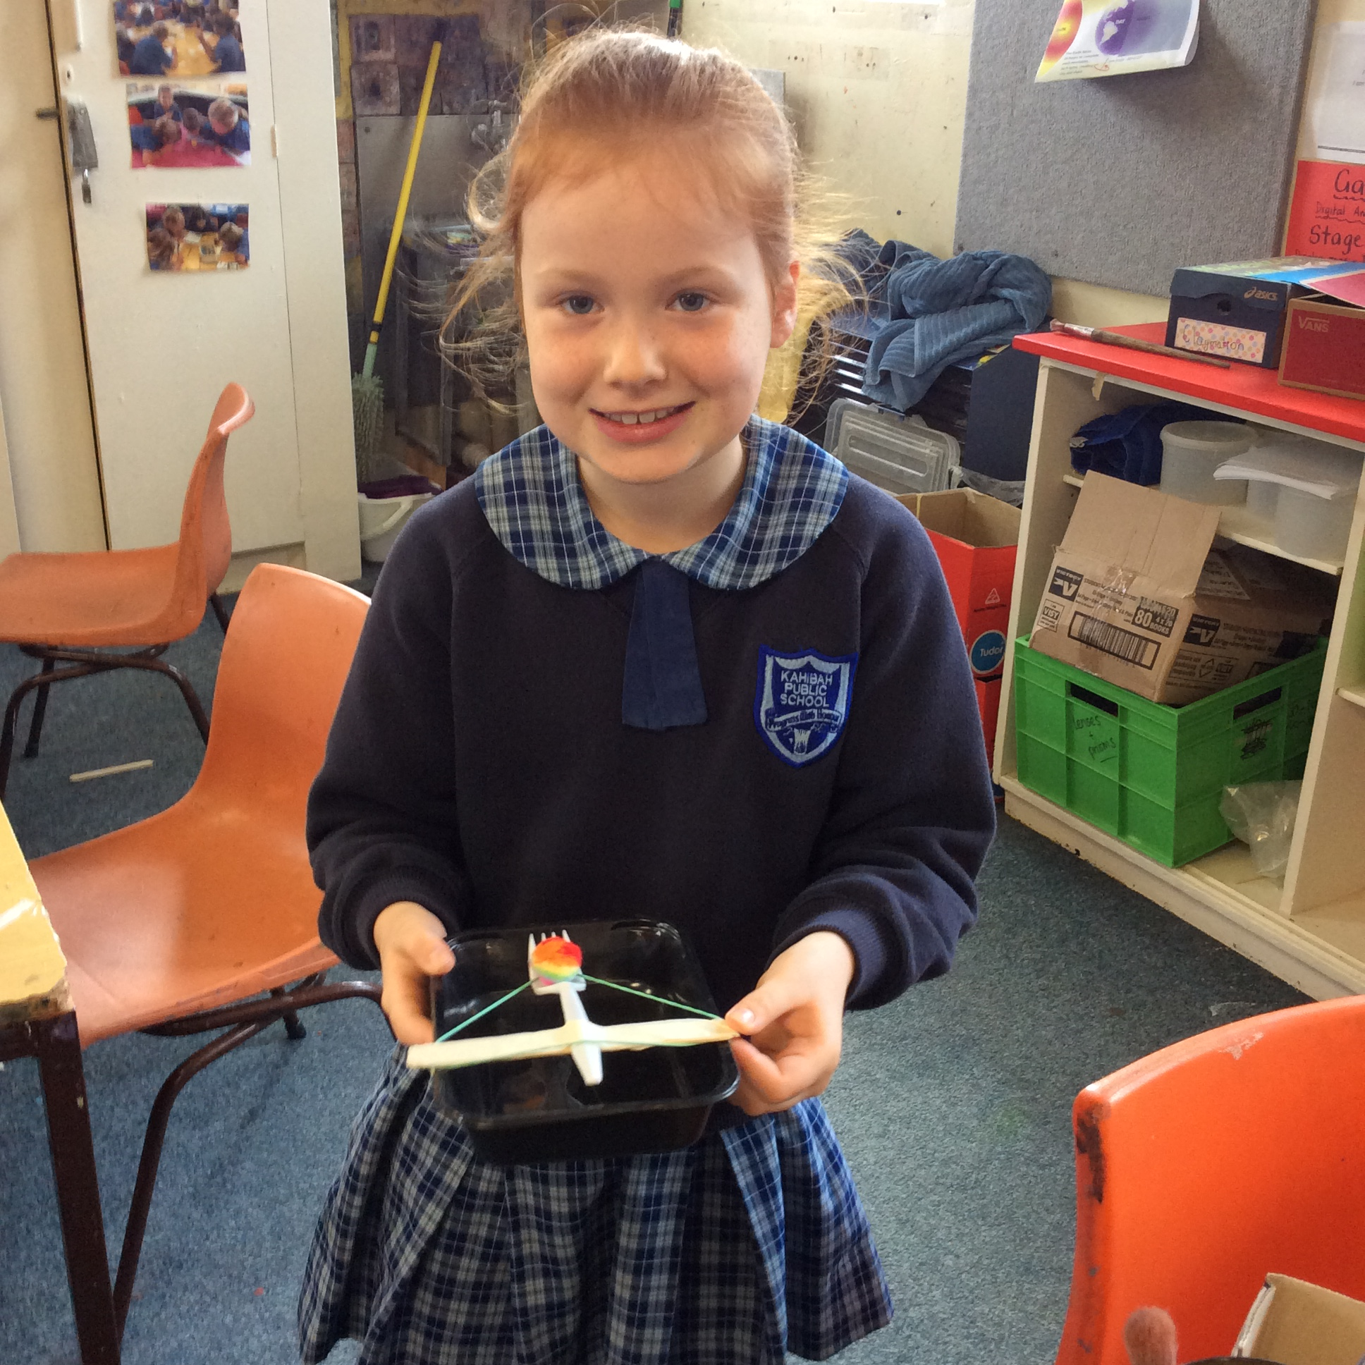

Slide 5

Robotics – Sphero SPRK

Slide 6
https://www.youtube.com/watch?v=Yg8LmEkI_0c
We decided to use Sphero, as it was cheap and dynamic. Funds were raised from a school disco donations from P and C.We operate it with $90 Lenovo tablets from JBHiFi – 10 units in total cost us $2k.
Our local High school is using Lego Mindstorms so we did not want to use a similar device.
We have implemented it with K-6 all students have been very excited and engaged.

Slide 7

Coding
Coding unplugged – Hour of Code activities.
We started with the hour of code on Code.org – stage 3 loved this.
We then trialed a 5 week Stage 2 GATS group – Dan helped me with some interesting student questions
This term all of Stage 2 have access to Scratch via a teacher account.
Finally I connected talented students with Newcastle Design School who started a code club.

Slide 8
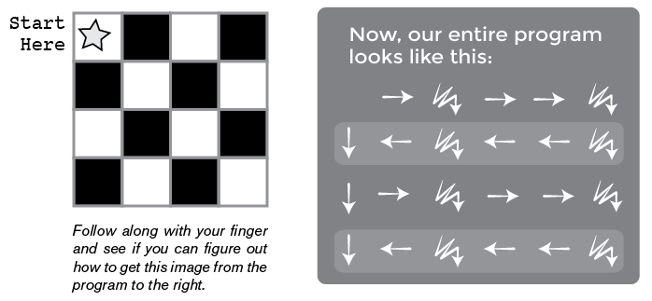
Unplugged Coding
https://code.org/curriculum/unplugged
Move it, Move it

Slide 10
BoSTES has started a review of the NSW K–10 technology syllabuses to consider incorporation of the Australian Curriculum: Technologies content, including how this may
impact on science and technology for K-6 students. This means that the Science and Technology K-6 and Technology Mandatory 7-8 syllabuses will be rewritten. Consultation on the Draft Directions for the development of these syllabuses ended last week.
To keep up-to-date with opportunities to participate in future consultations subscribe to the BOSTES Bulletin or keep an eye on SchoolBiz.
Schools should continue to teach the current NSW K-6 Science and Technology and
Years 7-10 Technology syllabuses during the review.

Slide 11
For ideas on how to integrate coding into the curriculum see…
http://k6.boardofstudies.nsw.edu.au/wps/portal/go/science-and-technology/statement-on-coding

Slide 12
Lesson Planning Session
Aims
Activity
Materials
Resources – Curriculum
Resources – Technologies & Approaches
The Lesson Plan Template
Sharing

Slide 13
Session Plan
Introduction to the Activity (10 minutes)
Collaborative Lesson Planning (50 minutes)
Sharing Session (30 minutes)

Slide 14
Aims
To create lesson plans that align with Digital Technologies curriculum concepts and the NSW syllabus
To share and discuss some of the predicted challenges and how they could be addressed
These plans don’t have to be perfect! This is an exercise to help you plan ways of using Coding and Computational Thinking in your classroom

Slide 15
Activity
You will be divided into groups with other teachers that teach the same Stage as you.
You will be given a lesson template to complete that addresses a content descriptor from the DT curriculum
http://www.australiancurriculum.edu.au/technologies/digital-technologies/curriculum/f-10?layout=1 (There is a link to this page on the CS4PS website)
At the end you will report back with your plan and share with the rest of the group

Slide 16
Materials
We will give you the following materials for this activity:
A Lesson Plan template (explained on the next few slides)
A sheet with the instructions for completing this activity
A sheet with key terms and concepts from the DT curriculum explained
You can use any of the technologies or approaches we have covered in this workshop in your lesson plan:
Scratch
Unplugged Approaches
AppInventor
Makey Makeys
LEGO Mindstorms

Slide 17
Resources - Curriculum
ACARA Digital Technologies Curriculum Website
Has the the content descriptors for F – 10
Explains some of the terms used in these descriptors
Has student work samples and their corresponding grades
BOSTES Coding across the Curriculum Guide
Has examples of how to incorporate Coding and Computational Thinking into NSW K-6 syllabuses
Digital Technologies Hub
Can search for resources by Stage, DT concepts covered
Also has work samples and guides for assessments

Slide 18
Resources – Technologies & Approaches
On the CS4PS website lesson planning activity page we have included a list of resources for the different technologies and approaches we have introduced in the workshop.
The CS4S website also contains all the materials from the other sessions, which may help you plan your lesson
You are welcome to plan the activity with another technology or approach,
e.g. your school/s may have a set of Spheros or Edison robots that you’d like to use

Slide 19
Lesson Plan Template
The template has the following rows to be filled in:
Digital Technologies Content Descriptor
NSW Syllabus Outcomes
Title and Introduction
Activity
Assessment and Reporting
Resources
These are explained on the next few slides

Slide 20
Lesson Plan Template
Content descriptor
This will be a content descriptor from the Digital Technologies curriculum, filled in already
We have included a sheet with the key terms used in these descriptors, but please ask if you need clarification on these or further examples
NSW Syllabus Outcomes
What syllabus outcomes does your lesson plan address? Think of cross-curricula approaches.

Slide 21
Lesson Plan Template
Title and Introduction
What is the title and focus of your lesson? The learning Intention
How do you plan to introduce the concepts to be covered in the lesson? Meta Language?
What is your ”hook” to get your students interested in the activity? A video, role play
Is there a real-life example that the activity can be related to?
E.g. a lesson on robotics might include examples of how robots are used in rescue missions or to explore buildings
Activity
What tasks will the students have to complete in the lesson/project? The Learning Sequence

Slide 22
Lesson Plan Template
Assessment and Reporting
How do you plan to assess the students’ learning in this lesson?
Note that some sample works and assessments are provided on ACARA’s website and Digital Technologies Hub, these may help you plan how to approach this
How do you plan to report students’ progress and share this with their parents or other stakeholders?
https://www.digitaltechnologieshub.edu.au/primary-teachers/effective-teaching/assessment-summative
Resources
What resources (both physical and digital) will be needed for this lesson?

Slide 23
Sharing
After completing the lesson plan template, you may want to create a summary of the activity to show the rest of the group
You can do this on pen/paper or in Word/Google Docs/the tool of your choice
An example, from the Digital Technologies Hub, that addresses one of the DT content descriptors is shown on the next slide.

Slide 24
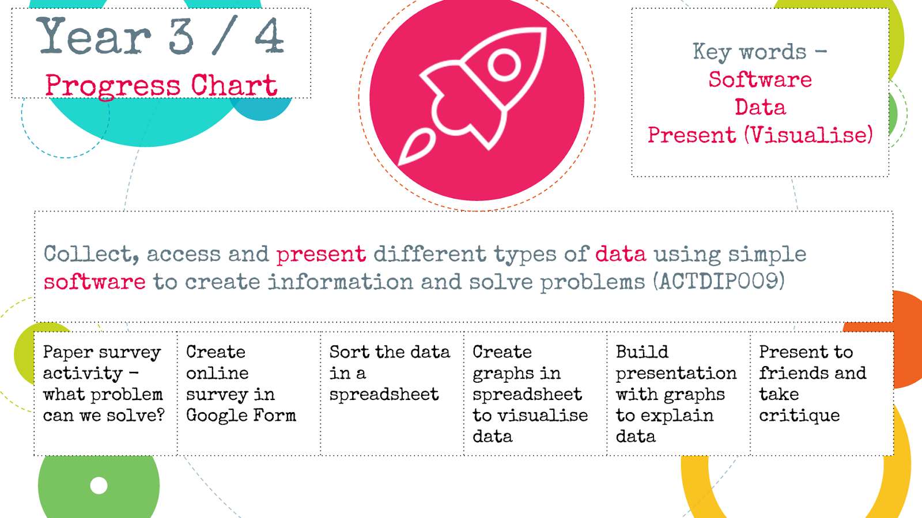
Example Summary

